Slide 1

DEPARTMENT OF COMPUTER ENGINEERING
SEMESTER | : | 5th
SUBJECT | : | DATABASE MANAGEMENT SYSTEM
CHAPTER | : | [1] INTRODUCTION TO DATABASE CONCEPTS
TOPIC | : | [1.1] INTRODUCTION, CHARACTERISTICS OF DATABASES, ADVANTAGES & DISADVANTAGES [1.2] FILE SYSTEM V/S DATABASE SYSTEM, USERS OF DATABASE SYSTEM
PRESENTED BY: PROF. MAYANK MANGAL

Slide 2



Objective
“ To make you known about the fundamentals
of Database Management System and Improve ourselves by taking valuable feedbacks from you.”

Slide 3
Objective
“ To make you known about the DBMS Users and difference between DBMS & File System.”

Slide 4
Contents
Introduction
What is Data ?
What is Information?
Database
Data Models
Components of Database System
What is DBMS ?
Database Languages
Advantages of DBMS
Disadvantages of DBMS
Examples of DBMS
Applications of DBMS

Slide 5
Contents
Difference b/w DBMS & File system
DBMS Users

Slide 6
Animation Link
https://www.youtube.com/watch?v=R1OSLQ33mWg
https://www.youtube.com/watch?v=d11viALaCvA

Slide 7
Animation Link
https://www.youtube.com/watch?v=4sUGoX6IXqM

Slide 8

What is Data ?
A collection of raw facts and figures.
Raw material that can be processed by any computing machine.
A collection of facts from which conclusions may be drawn.
Data can be represented in the form of: numbers and words which can be
stored in computer‟s language.
i.e. Ankit Sanghavi, Vivek 007

Slide 9
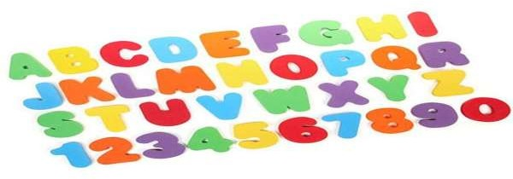
What is Information?
Systematic and meaningful form of data.
Knowledge acquired through study or experience.
Information helps human beings in their decision making.

Slide 10

Database
A repository of logically related and similar data.
An organized collection of related information so that it can easily be accessed, managed and updated.
E.g.:
Dictionary Airline Database Student Database Library
Railways Timetable YouTube (All songs of Rahul Vaidya)

Slide 11
Data Models, Schema and Instances
Data Models:
-Describes structure of the database.
-Aim is to support the development of information systems by providing the definition and format of data.
-If the same data structures are used to store and access data then different applications can share data.
-Classification:
High-Level Model
Representation Model
Low-Level Model

Slide 12
1. High-Level Model
Ensures data requirement of the users.
Not concerned with representation, but it's a conceptual form.
Three Imp terms:
Entity: - Any object, exists physically or conceptually. b)Attribute:- Property or characteristic of entity. c)Relationship:- Association or link b/w two entities.
These 3 terms make Entity-Relationship Model.

Slide 13
Entity-Relationship (E-R) Model
College |  | Principal
College 1
Course A
Student A
College 2
Course B
College
Student B
College 3
Course C
Student C
Relationships E-R diagram
Stud_Name
Stud_Roll No
Course_Id
Course_Name
Student
Admission
Course

Slide 14
2. Representation Model
Representation of data stored inside a database.
Describes the physical structure of the database.
It uses the concepts which are close to the end-users.
Classification:
Hierarchical
Relational
Network

Slide 15
a. Hierarchical Database Model
Developed by IBM, is the Oldest database model.
Represented using a tree-diagram. (Parent-child relationship)
Each box is called a "Node"
Director
Manager
(HR)
Manager (Sales)
Manager
(Market.)
The nodes represent a record type.
Area Manager 2
Area
Manager
1
Area
Manager 3
A line connecting nodes represent the link.
Sales Exe.
1
Sales Exe.
2
Sales
Representative

Slide 16
Cont…
Parent-child type is suited for One-to-many
relationship between two entities.
Director
But difficult to implement many-to-many relationship. e.g.:
IMS system from IBM.
Manager
(HR)
Manager (Sales)
Manager
(Market.)
Area
Manager 1
Area Manager 2
Area
Manager 3
Sales Exe.
1
Sales Exe.
2
Sales
Representative

Slide 17
b. Relational Database Model
Simplest and the most common model.
Developed in 1970 by E.F. Codd, it became commercial in the 80s.
Data elements are stored in different tables made up of rows and columns.
Roll No | Name | Surname | Section
1001 | Rajkumar | Tomar | D
1002 | Rajkumar | Singh | D

Slide 18
Cont…
Terminologies:
-Data Values: alphanumeric raw data (Rajkumar)
-Columns: fields (item or object that holds the data)
-Rows: record (a group of data for related field)
-Table: collection (all records & fields)
-Key: identifier (uniquely identifies a row in the table. It can be value of a single or multiple column. e.g.:
DB2, ORACLE, SQL Server.
Roll No | Name | Surname | Section
1001 | Rajkumar | Tomar | D
1002 | Rajkumar | Singh | D

Slide 19
c. Network Database Model
Represented using a Data-Structure Diagram.
Boxes represents the records & lines the links.
Based on
"owner-member relationship."
Members of an owner may
be many but for many membe owner is one.
Can represent one-to-one and many-to-many as well.
Teacher 1
Teacher 2
Teacher 3
rs
Course A
Course B
Course C
Student 1
Student 2
Student 3

Slide 20
Cont…
One-to-many relationship is converted into a set of one-to-one.
Also, many-to-many is converted into 2 or more one-to-many relationship.
e.g.:
IDMS, IMAGE.
Teacher 1
Teacher 2
Teacher 3
Course A
Course B
Course C
Student 1
Student 2
Student 3

Slide 21
Components of Database System
Users- People who interact with the
database:
Application Programmers.
End Users.
Users
Components of database
- Data Administrators.
Data
Software
Software- Lies between the stored data and the users:
DBMS.
Application Software.
User Interface.
Hardware

Slide 22
Cont…
Hardware- Physical device on which database resides.
Users
e.g.:
Computers, Disk Drives, Printers, Cables etc.
Components of database
Data
Software
Data- numbers, characters, pictures. e.g.:
Shri Shri Nilesh, 1008, India.
Hardware

Slide 23

What is DBMS ?
A set of programs to access the interrelated data.
DBMS contains information about a particular enterprise.
Computerized record keeping system.
Provides convenient environment to user to perform operations:
-Creation, Insertion, Deletion, Updating & Retrieval of information.

Slide 24

Database Languages
Once data is filled, manipulation is required (insertion, deletion, modification of data)
For these, a set of languages is provided by DBMS:
Data Definition Language.
Data Manipulation Language.
Data Control Language.

Slide 25
Advantages of DBMS
Controlling Data Redundancy: Data is recorded in only one place in the database and it is not duplicated.
Data Consistency: Data item appears only once, and the updated value is immediately available to all users.
Control Over Concurrency : In a computer file-based system in updating, one may overwrite the values recorded by the other.
Backup and Recovery Procedures: automatically create the backup of data and restore data if required.
Data Independence: Separation of data structure of database from application program that uses the data is called data independence.

Slide 26
Disadvantages of DBMS
Cost of Hardware and Software: Processor with high speed of data processing and memory of large size is required.
Cost of Data Conversion: Very difficult and costly method to convert data of data file into database.
Cost of Staff Training: A lot of amount for the training of staff to run the DBMS.
Appointing Technical Staff: Trained technical persons such as database administrator, application programmers, data entry operators etc. are required to handle the DBMS.
Database Damage: All data is integrated into a single database. If
database is damaged due to electric failure or database is corrupted
on the storage media, then your valuable data may be lost forever.

Slide 27
Examples of DBMS
Some of the common used DBMSs are:
-Oracle, IBM‟s DB2, Microsoft‟s SQL Server, MS-Access and Informix.
Some of the desktop based DBMSs are:
-Microsoft FoxPro, Borland dBase and
Microsoft Access.

Slide 28
Applications of DBMS
Airlines and Railways: Online databases for reservation, and displaying the schedule information.
Banking: Customer inquiry, accounts, loans, and other transactions.
Education: Course registration, result, and other information.
Telecommunications: Communication network, telephone numbers, record of calls, for generating monthly bills, etc.
E-commerce: Business activity such as online shopping, booking of holiday package, consulting a doctor, etc.
Human resources: Organizations use databases for storing information about their employees, salaries, benefits, taxes, and for generating salary checks.

Slide 29
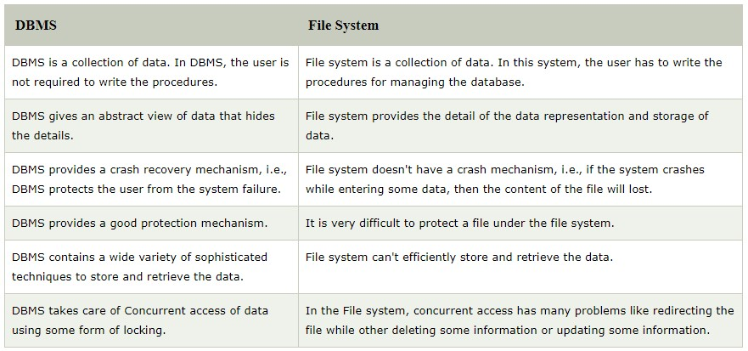
DBMS V/S FILE SYSTEM:

Slide 30





DBMS Users
End users
s/w Engineers
Database Admin
Classified into mainly three category

Slide 31
End User:
Deal only with the highest level of abstraction.
May not be concerned with the details of the DBMS.
Involved in updates to the database or queries on the database
Categories of end users
Casual End Users
Naïve or Parametric users
Sophisticated users
Specialized users

Slide 32

I. Casual End Users
Access data base occasionally when needed
They need different information each time
They use sophisticated query language to specify their request
example: High level Managers who access the data weekly or biweekly.

Slide 33

II. Naive or parametric users
They make up large section of the database
They communicate with the database on regular period
communicate with the system by invoking one of the applications programs that have been written previously
Their job is to constantly querying and updating database using standard queries
This is called canned transaction
Ex: Bank teller, reservation clerks etc

Slide 34


III. Sophisticated users
They include business analyst , scientist, engineers, other thoroughly familiar with the system capability
They interact with the system without writing programs, instead they form their requests in a database query language
They submit each query to a query processor

Slide 35

query processor : Its function is to break down DML statements into instructions that the storage manager can understands

Slide 36


Storage manager : It is a program module that provides the interface between the low level data stored in the database and application programs and queries submitted to the system
It translates various DML statements into low level file system commands

Slide 37

IV. Specialized users
Also Sophisticated users who write specialized database application that do not fit into the traditional data processing framework
Write specialized applications like CAD (Computer Aided design),Multimedia database programs

Slide 38

B) S/w Engineers
I. Application programmer
→Writing database programs in some programming languages (Such as COBOL,C++ or some forth generation languages)
→ Application programs access database by issuing the appropriate request to the DBMS.

Slide 39

II. Systems analysts
Architects, as well as the project leaders, of an information system.
It is their job to
Develop solutions to users problems
Determine the technical and operational feasibility of their solutions
Estimate the costs to develop and implement them.

Slide 40


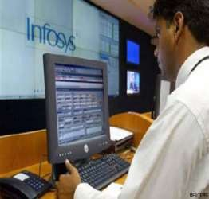


Software Engineers
Application programmer
System Analyst

Slide 41

C) Database Administrator
The DBA can be a single person or a team comprising a group of persons

Slide 42
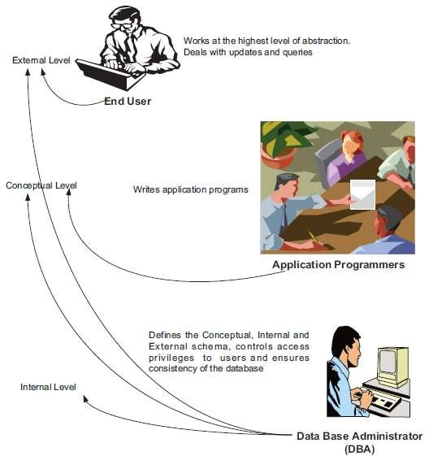

Slide 43
Outcome
Students are able to demonstrate data, information, database and DBMS.
Students are able to answer why and how they can use DBMS.

Slide 44
Outcome
Students are able to differentiate DBMS and File system.
Students are able to conclude about different DBMS users.

Slide 45
Bibliography
URLs:
http://www.wikipedia.org
http://computer-dbms.blogspot.in http://www.slideshare.net http://my.safaribooksonline.com http://www.123rf.com
Books:
Computer Fundamentals -Anita Goel.
DBMS: Principles & Products -Charles J. Bontempo and Cynthia Maro Sarcoo.
Modern DBMS -Jeffry A. Hoffer, Marry B. Prescott and Fred R. Mcfadden.
Information Technology training Program, Module II, CA-IPC
Computer Fundamentals – P. K. Sinha

Slide 46
Thank You!

Slide 47
?
Queries…

